Slide 1
Bird Strike Committee USA
Update & Awards
August 2021

Slide 2
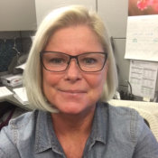
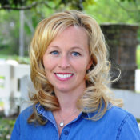
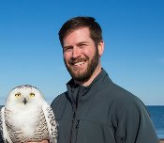
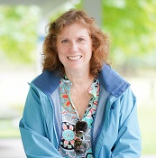
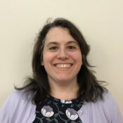
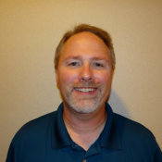
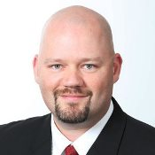
BSC USA Steering Committee Departing Members 2020
NAME | COMPANY | INDUSTRY GROUP
Janny Siddens | FAA | FAA
Sarah Brammell | Blue Wing Environmental | Private Sector Services
Jeff Turner | Boston-Logan (BOS) | Airports
Kim Owen | Boeing | Aerospace Industry
Tahereh Behbehani | Southwest Airlines | Airlines
John Ostrom | Minneapolis-St. Paul (MSP) | Chair – Conference Subcommittee
Craig Quick | GE Aviation | Chair - Research and Development Subcommittee
Janny Siddens
Sarah Brammell
Jeff Turner
Kimberly Owen
Tahereh Behbehani
John Ostrom
Craig Quick

Slide 3
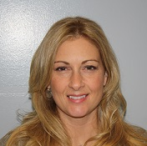
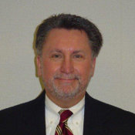
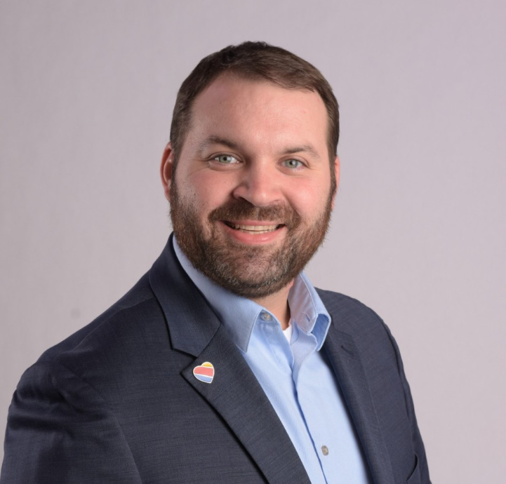
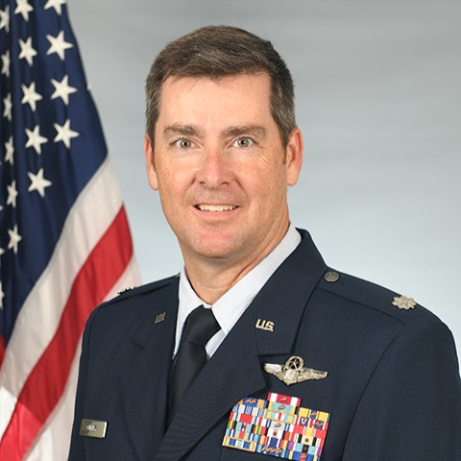
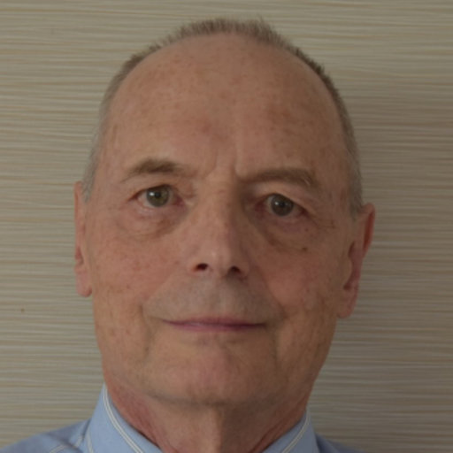

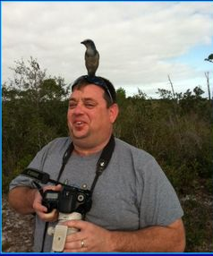


BSC USA Steering Committee Arriving Members 2020
NAME | COMPANY | INDUSTRY GROUP
Amy Anderson | FAA | FAA
Michael Stephens | Dane County Airport | Airports
Matthew Jones | Southwest Airlines | Airlines
Mike Culley | ANG | DOD
Roger Nicholson | - | General
Eric Kershner | USFWS | Industry Liaison
John Ostrom | Minneapolis-St. Paul (MSP) | Emeritus
Sarah Brammell | Blue Wing Environmental | Emeritus
Kim Owen | Boeing | Chair - Research and Development Subcommittee
Amy Anderson
Michael Stephens
Matt
Jones
Mike Culley
Roger Nicholson
Kimberly Owen
Eric Kershner
John Ostrom
Sarah Brammell

Slide 4
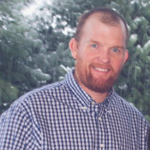
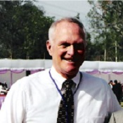
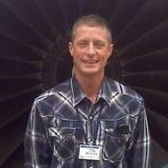

BSC USA Steering Committee Departing Members 2021
NAME | COMPANY | INDUSTRY GROUP
Travis Guerrant | USDA | USDA
Dave Moore | Strategic Results | Private Sector Services
Troy Levanen | Alaska Airlines | Airlines
Michael Stephens | Dane County Airport Authority | Chair - Outreach & Education Subcommittee
Travis Guerrant
Dave Moore
Troy Levanen
Michael Stephens

Slide 5
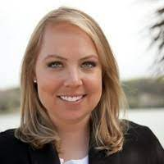
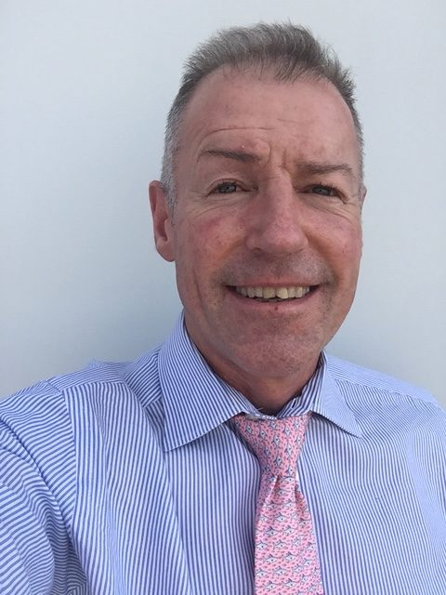
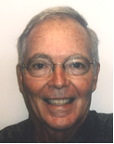
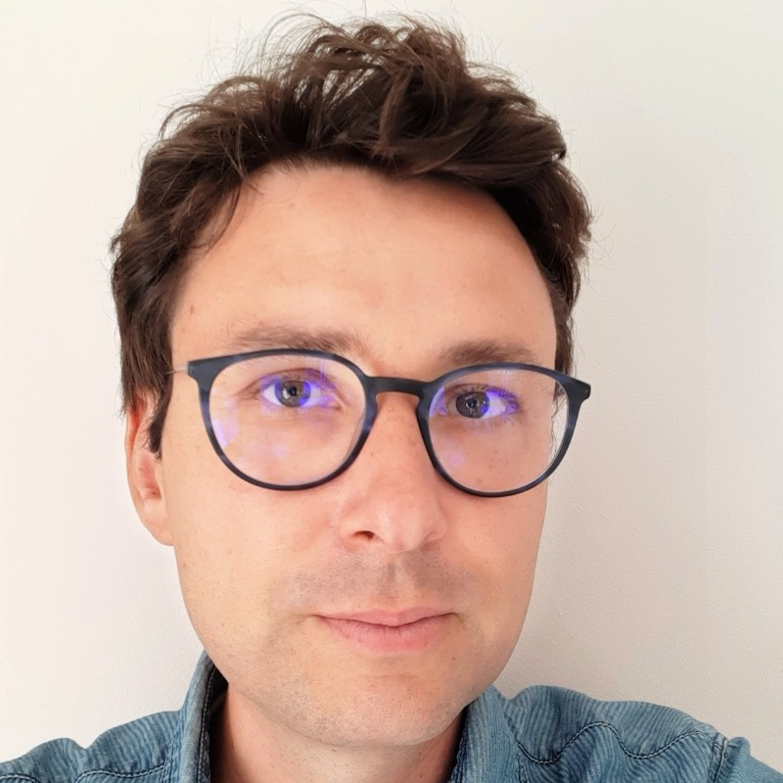
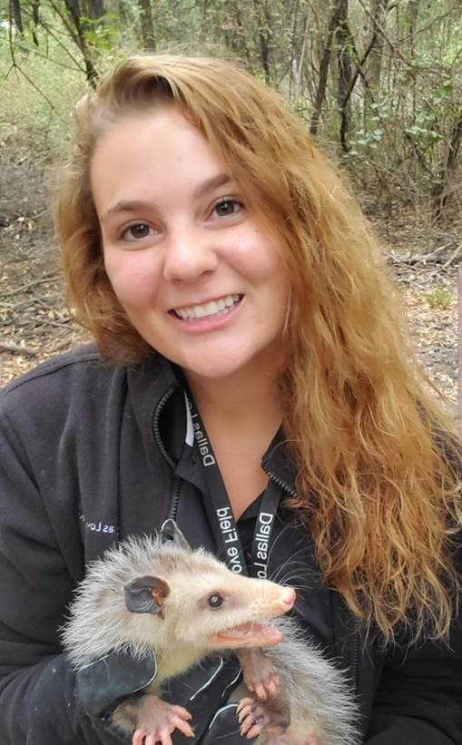
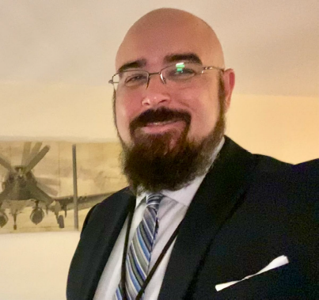
BSC USA Steering Committee Arriving Members 2021
NAME | COMPANY | INDUSTRY GROUP
Amy Reed | FAA | FAA
Joe Barnes | Lumen International, Inc. | Private Sector Services
Jay Tischendorf | AERIE Institute | General
Alison Doran | ERS | Private Sector Services
Matthew Powers | Dane County Airport Authority | Chair - Outreach & Education Subcommittee
Antoine Pilon | Airbus | Industry Liaison
Amy Reed
Jay Tischendorf
Joe Barnes
Antoine Pilon
Alison Doran
Matthew Powers

Slide 6
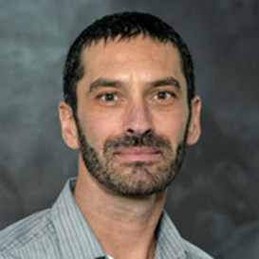

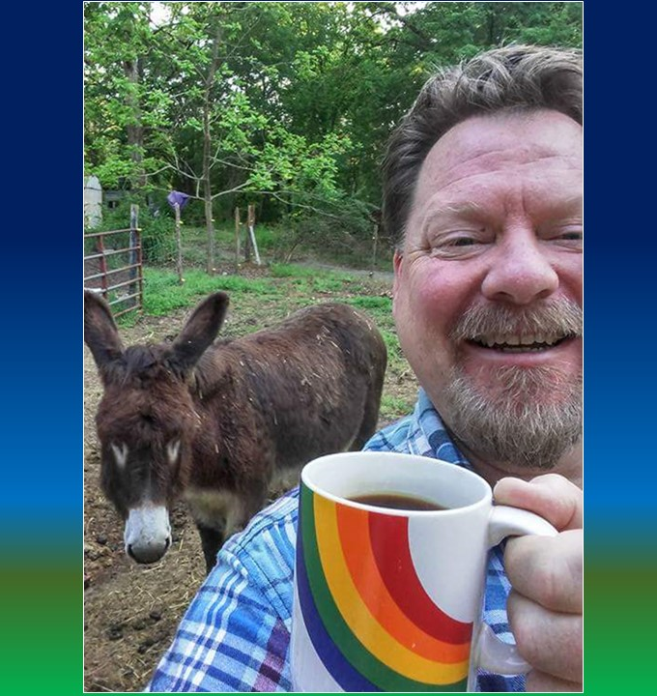
BSC USA EXECUTIVE COMMITTEE
Nick Atwell | Portland (PDX) | Chair BSC Steering Committee
Craig Quick | GE Aviation | Vice-Chair BSC Steering Committee
John Weller | FAA | Past-Chair BSC Steering Committee
Nick Atwell
BSC USA Chair
Craig Quick
BSC USA vice-Chair
John Weller
BSC USA past-Chair

Slide 7
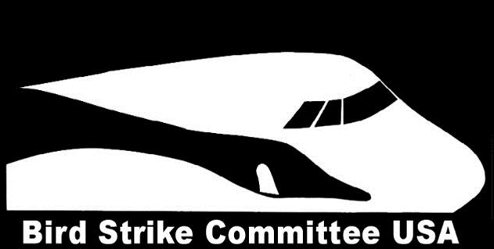
Bird Strike Committee USA
Lifetime
Achievement
Award
BSC USA Annual Conference
August 16, 2021
Notes:
Today we are here to present a very special honor.
The Bird Strike Committee USA Lifetime Achievement Award is given to acknowledge colleagues who have consistently been active and productive in the bird strike community.
These colleagues are proven professionals in the bird strike world and deserve special recognition for their years of service.
Since the beginning of the Bird Strike Committee USA in 1992, only 7 people have received this honor.

Slide 8
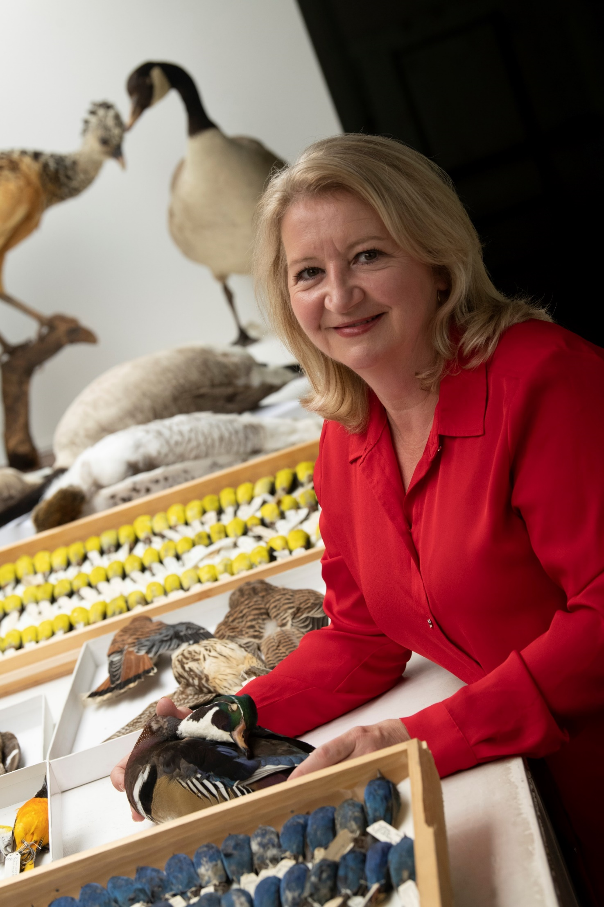
Lifetime Achievement Award BSC USA 2021
Carla Dove
Program Manager
Feather Identification Lab
Smithsonian Institution
Photo by
Kegley for
SI FIL
Notes:
Today, it is my pleasure to add another name to this group of honorees and present the Bird Strike Committee USA Lifetime Achievement Award to… Carla Dove… the Program Manager of the Smithsonian Institution, Feather Identification Lab.

Slide 9
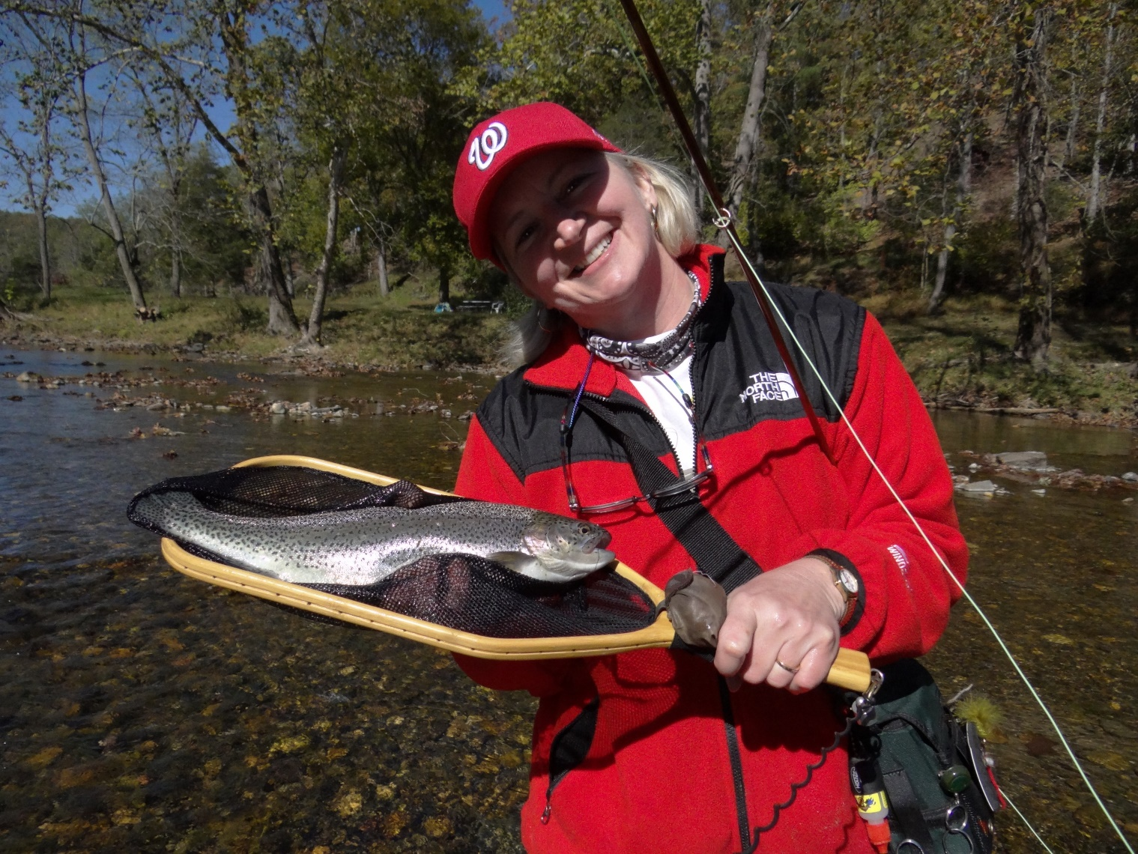
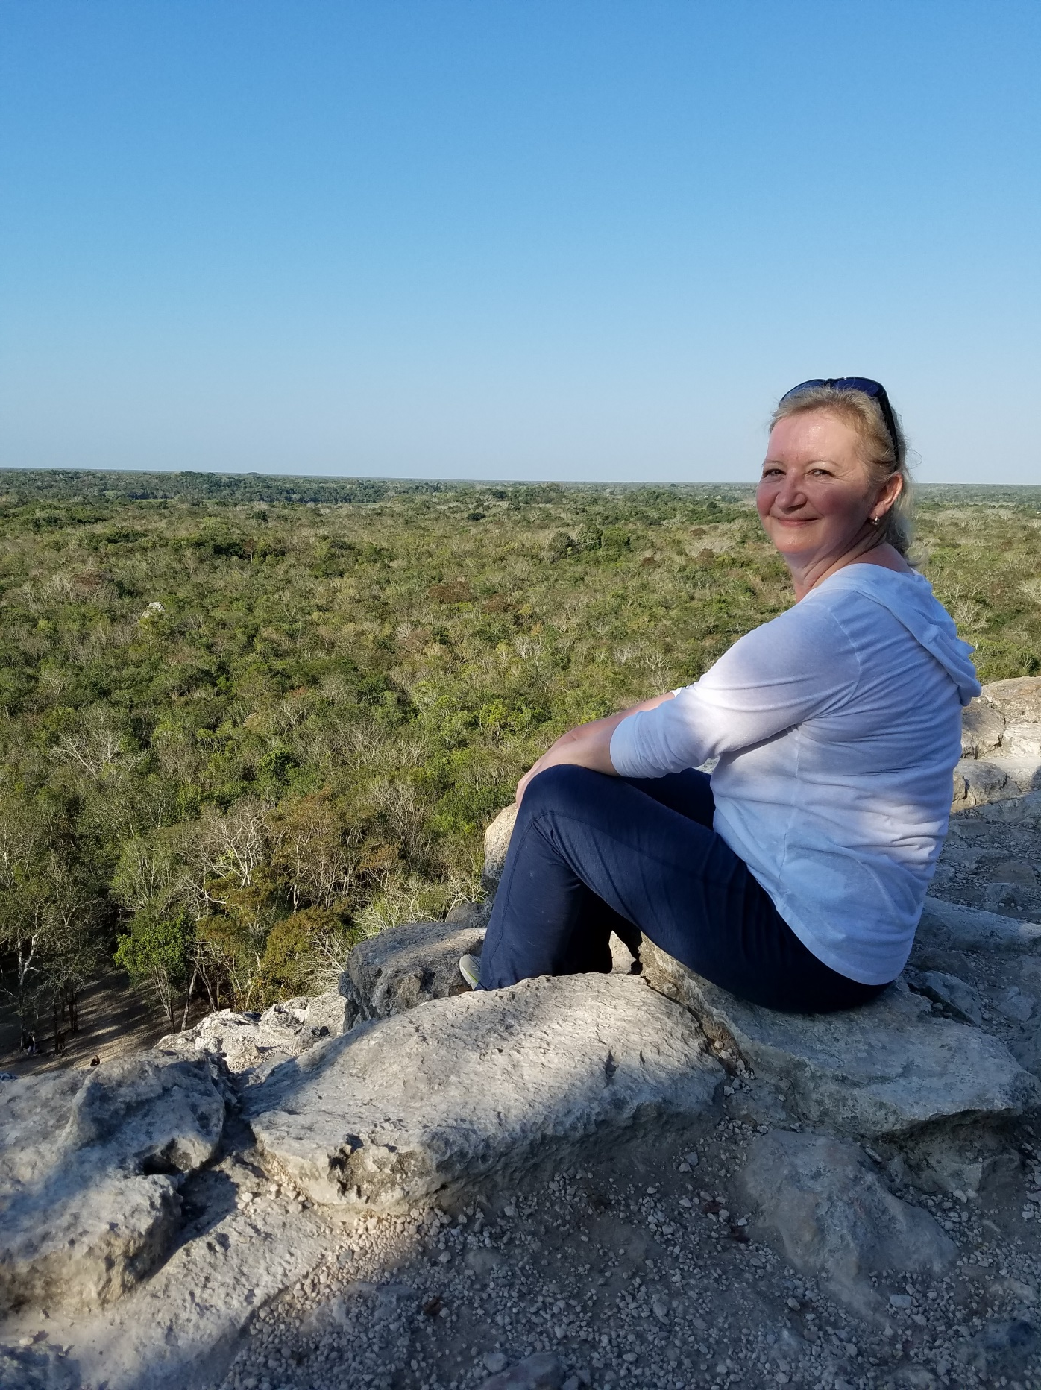
Lifetime Achievement Award BSC USA 2021
Carla Dove
1983 – A.S Natural Resource Management
Lord Fairfax Community College, VA
1986 – B.S. Wildlife Biology
University of Montana, MT
Photos by C. Milensky
Notes:
Carla was raised on a farm in the Shenandoah mountains of mid-western Virginia.
This upbringing gave her the work ethic and love of nature that would be the basis of her journey to where she is today.
Carla had 3 important mentors in her college education and early career.
One during her years at Lord Fairfax Community College in Virginia and one at the University of Montana in Missoula.
These early mentors introduced Carla to ornithology and natural history museum collections – providing a big influence and foundation for her future.

Slide 10
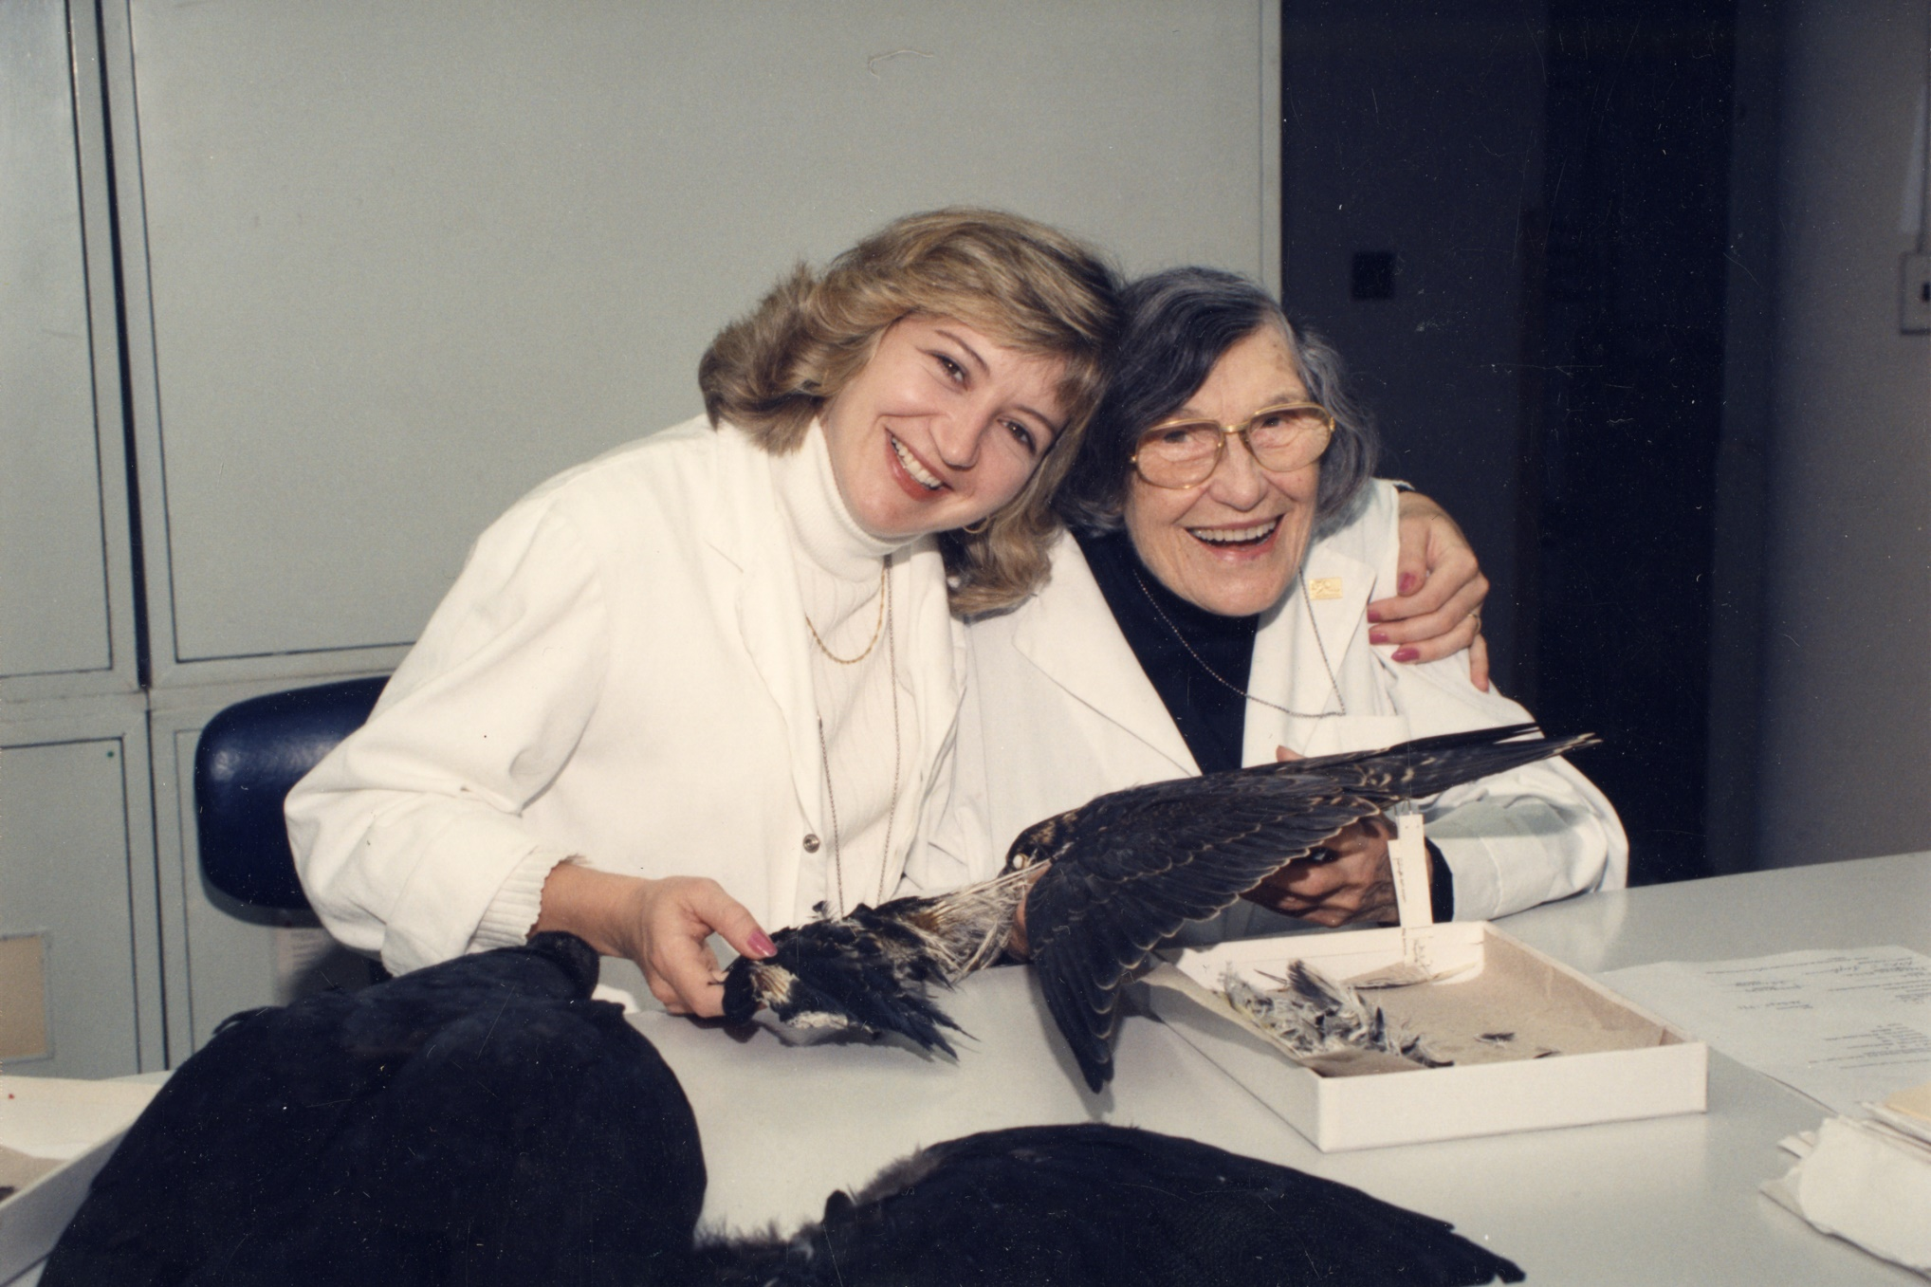
Lifetime Achievement Award BSC USA 2021
Carla Dove
1996
1989 – Started working at Smithsonian Bird Division
Began volunteering with Roxie Laybourne
1992 – Attended first BSC USA meeting
JFK International Airport, NY
1994 – M.S. Systematics, Evolution and Population Biology
George Mason University, VA
1998 – Ph.D Environmental Science and Public Policy
George Mason University, VA
Dissertation on feather microstructure of
shorebirds
Photo courtesy of SI Archives
Notes:
In 1989, Carla started working for the Smithsonian Institution Division of Birds as a museum technician.
This is when she met her third mentor - Roxie Laybourne.
At that time, Roxie was working in the Bird Division identifying bird strike material based on the methods she developed using feather characters and the Bird Division specimen collection.
Carla was so interested in the work that Roxie was doing that she started volunteering after her work hours to learn more about identifying feathers from bird strike remains.
In 1992, Carla attended the first ‘official’ Bird Strike Committee meeting with Roxie at JFK International Airport.
By this time, Carla was hooked on feather identification and began working towards making a career of this unique specialty.
During her apprenticeship with Roxie, Carla continued her education and went on to get her Master’s and Doctoral degree specializing in feather microstructure with emphasis on bird strike material.

Slide 11
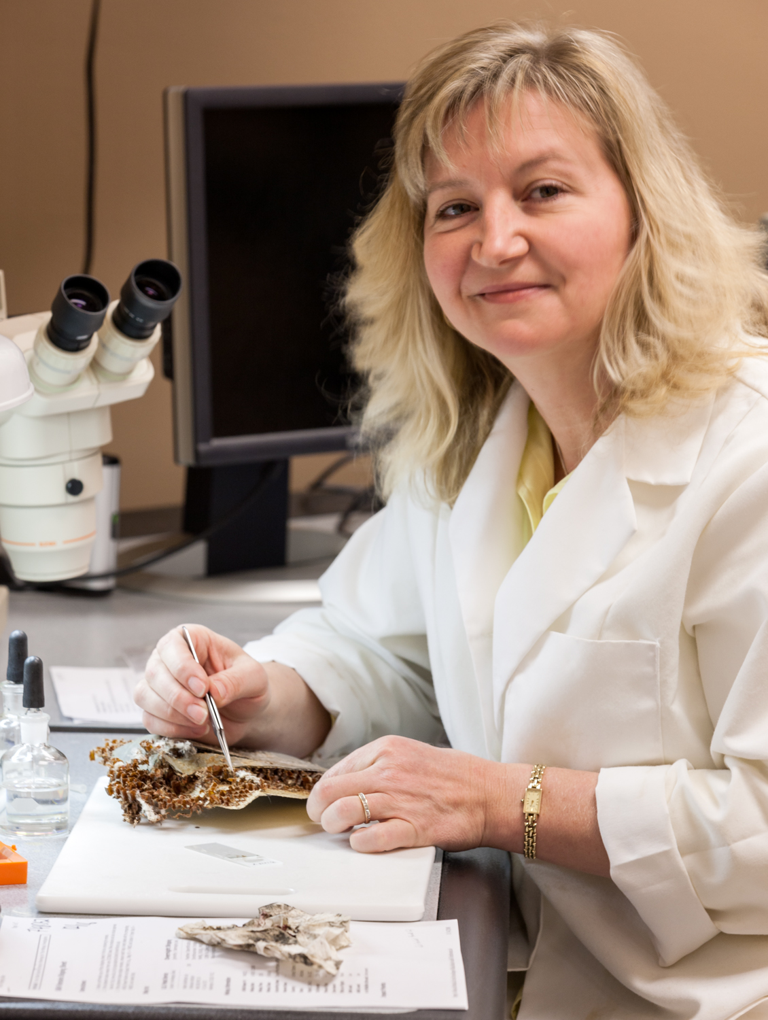
Lifetime Achievement Award BSC USA 2021
Carla Dove
Over 40 peer reviewed publications
Countless PR, Technical Reports, Teaching Documents
Mentor / Advisor to many students including:
4 Post-doctoral Fellows
2 Masters Degree Students
1 Smithsonian Fellow
George Mason University, past Affiliate Professor
Member of 9 professional organizations including:
American Ornithological Society, Elected Fellow
Wilson Ornithological Society, past Council Member,
Bird Strike Committee USA, past Steering Committee Member
Photo by SI Photo Services
Notes:
By the year 2000, Carla had become the manager of the bird strike identification program at the Smithsonian.
Her career to date is a testament to the productivity and enthusiasm for her work.
She continues to contribute to ornithology with over 40 peer reviewed publications and countless professional documents and reports.
Teaching and mentoring is also an important part of Carla’s work philosophy.
Even though she has been an advisor for several graduate and many undergraduate students - Carla is just as dedicated to teaching young students and the public about ornithology, bird strikes and feather identification.
Carla also continues to be an active member of professional organizations for ornithology and the bird strike community.
She is an elected Fellow in the American Ornithological Society and continues to be an integral member of the Bird Strike Committee USA.

Slide 12
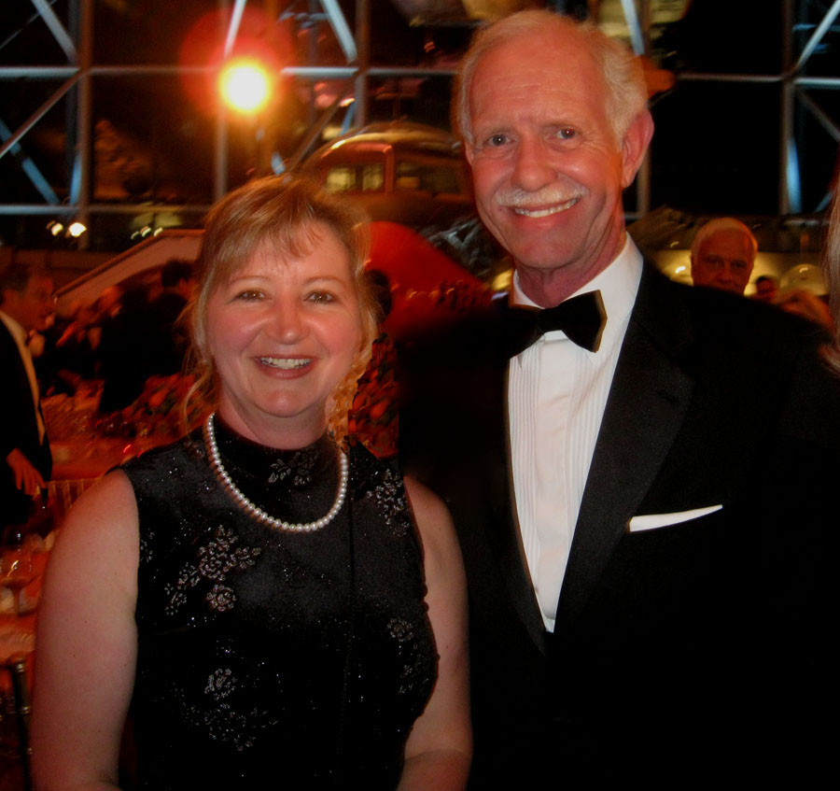

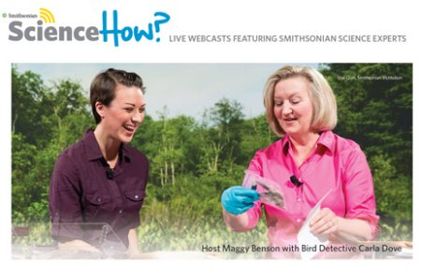
Lifetime Achievement Award BSC USA 2021
Carla Dove
Program Manager Smithsonian Feather ID Lab
World Expert on Feather Microstructure
Promoter for Smithsonian Natural History Collections
Spokesperson for Bird Strike Community
Mentor and Teacher
Photo courtesy of C. Dove
Carla
and
Captain
“Sully”
Sullenberger
Carla during
nationwide live
webcast for
young students
Screenshot courtesy SI Affiliates
Notes:
To summarize, Carla Dove is not just a lab manager. She is a world expert, spokesperson, mentor and much more.
Over the past 20 years, Carla’s hard work and forward thinking has established the Smithsonian Feather Identification Lab as a world- renowned resource for bird strikes and ornithology.
Her years of experience and dedication to her work is an example we all can appreciate.

Slide 13
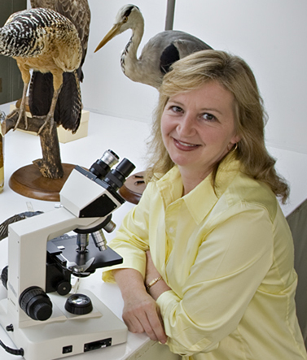
Lifetime Achievement Award BSC USA 2021
Carla Dove
“For your incomparable commitment benefitting U.S. and international aviation safety. Your expertise and exceptional leadership of the Feather Identification Laboratory has provided the foundation of an
unparalleled investigative science that will continue to benefit the world’s civil / military aviation and
wildlife alike.”
Photo by
J. DiLoreto
SI Photo Svcs
- Award Inscription
Notes:
So – once again – it is my pleasure to award the Bird Strike Committee USA Lifetime Achievement award to Carla Dove…
As the inscription on the award states – we thank you …
“For your incomparable commitment benefitting U.S. and international aviation safety. Your expertise and exceptional leadership of the Feather Identification Laboratory has provided the foundation of an unparalleled investigative science that will continue to benefit the world’s…aviation and wildlife alike.”

Slide 14
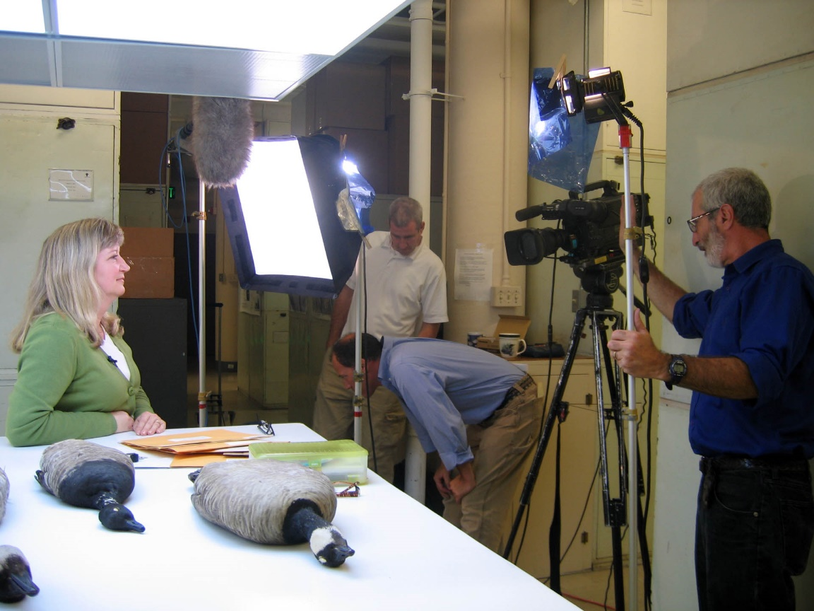
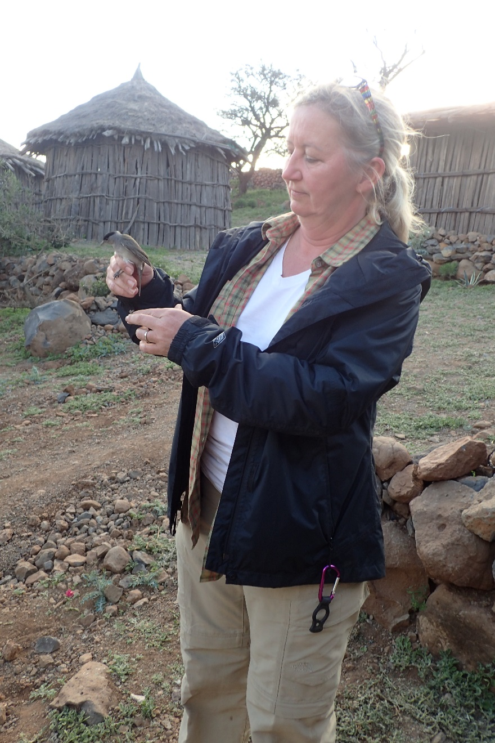
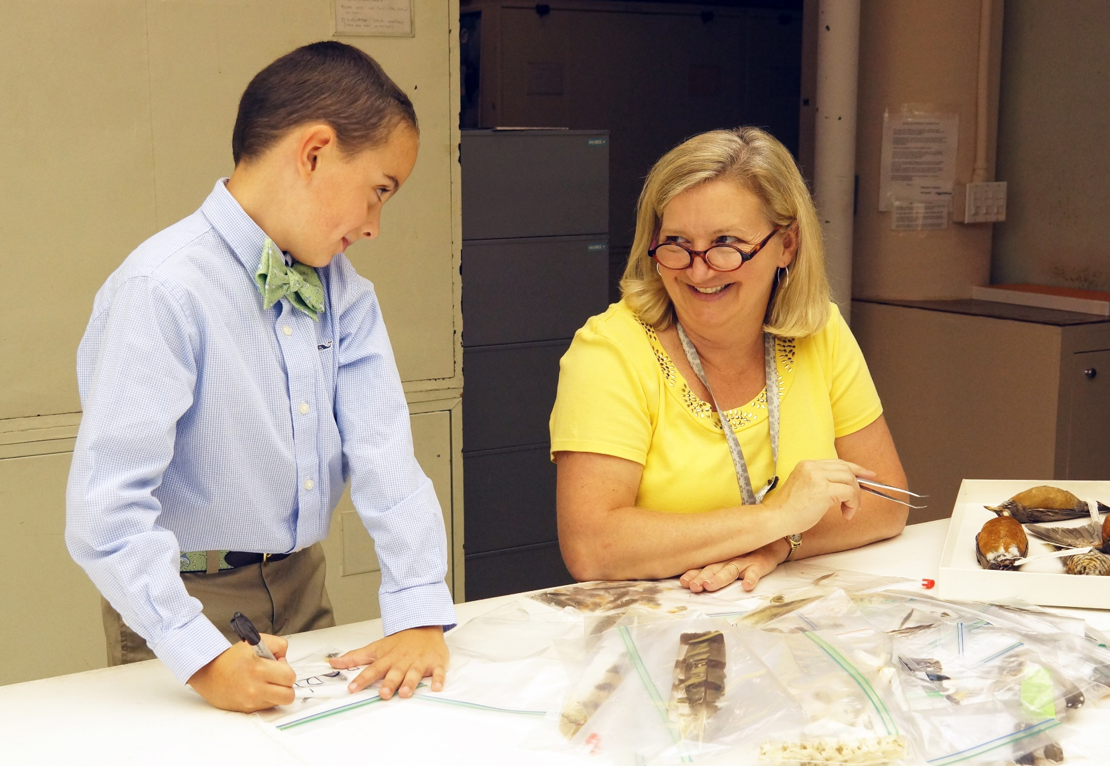
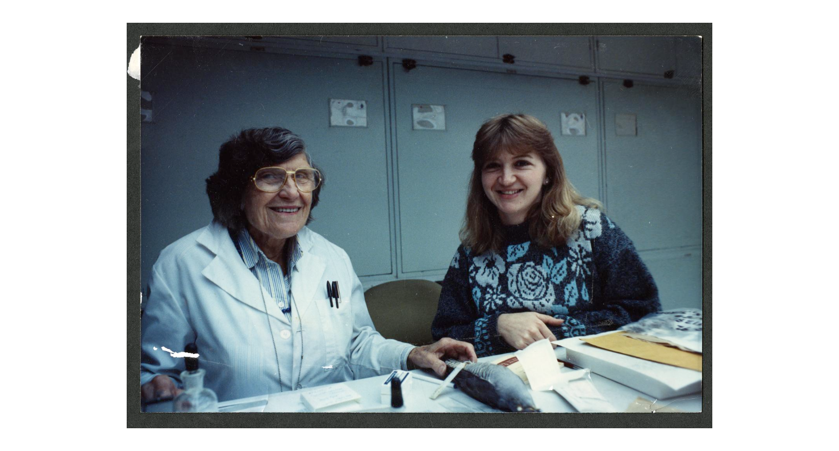
Lifetime Achievement Award BSC USA 2021
Carla Dove
Smile
For The
Cameras!
CONGRATULATIONS CARLA !
~1989
Feather Experts!
Photo courtesy of SI Archives
Photos courtesy
of J. Whatton
Djibouti 2016
Notes:
Congratulations Carla on this well-deserved award!
While this is still a ‘virtual’ presentation, we look forward to when we can physically get together and hand you this award in person.
For everyone watching, we will be posting photos of Carla’s award – so be sure to look for those on the BSC USA website.
Carla – at this point, I’ll open it up to you if you have any comments.

